Slide 1


Python Project
( BDA5)
TATIANA SHUPIK
Customer Churn Analysis
12.2024

Slide 2

The problem
Customer churn is one of the most important metrics for a growing business to evaluate. It's easier to save an existing customer before they leave than to convince them to come back. Understanding and preventing customer churn is critical to company's long-term success.
•What are we trying to predict?•
In this project, we will use statistical testing to analyze the key factors of customers who are more likely to churn, develop a classification model to predict churn based on those factors, and provide recommendations for retaining customers as well as predictions of churn for a list of customers (delivered via csv).
Business Goals
- Find drivers for customer churn. Why are customers churning?
- Construct a ML classification model that accurately predicts customer churn.
- Deliver a report that a non-data scientist can read through and understand what steps were taken, why and what was the outcome?

Slide 3

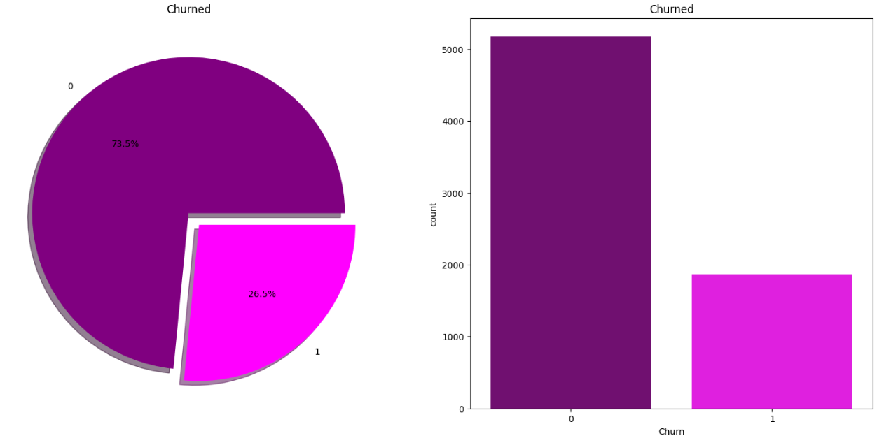
Churn
What data is available for that?
We will use the Customer Churn dataset for this analysis (churn.csv).
We will use a Jupyter Notebook to run code snippets.
We will create visualizations in Python.
What can be motivation and applications for solving the
problem?
We will use the following libraries - Pandas, Matplotlib, Seaborn and Scikit-Learn.
Each user is identified through a unique customer ID. There are 19 independent variables used to predict the target feature – customer churn.
Let’s count the number of customers in the dataset who have churned:
Notes:
Photos by Freepik

Slide 4


Data Descriptions
______________________________________________________________________________________________________________________________________________________________________
Churn: Whether the customer churned or not (Yes or No).
Number of features in the data set: 21. These features can also be sub-divided into:
Customer account information
Demographic customer information
Services that each customer has signed up for
Tenure , Contract , PaperlessBilling , PaymentMethod , MonthlyCharges , TotalCharges
Gender , SeniorCitizen , Partner , Dependents
PhoneService , MultipleLines , InternetService , OnlineSecurity , OnlineBackup , DeviceProtection , TechSupport , StreamingTV , StreamingMovies
4

Slide 5

What is the distribution of the labels? _________________________________________________________________________________________________
17 Categorical features:
CustomerID: Customer ID unique for each customer
3 Numerical features:
Tenure: Number of months the customer has stayed with the company
gender: Whether the customer is a male or a female
SeniorCitizen: Whether the customer is a senior citizen or not (1, 0)
Partner: Whether the customer has a partner or not (Yes, No)
Dependent: Whether the customer has dependents or not (Yes, No)
PhoneService: Whether the customer has a phone service or not (Yes, No)
MultipeLines: Whether the customer has multiple lines or not (Yes, No, No phone service)
InternetService: Customer’s internet service provider (DSL, Fiber optic, No)
OnlineSecurity: Whether the customer has online security or not (Yes, No, No internet service)
OnlineBackup: Whether the customer has an online backup or not (Yes, No, No internet service)
DeviceProtection: Whether the customer has device protection or not (Yes, No, No internet service)
TechSupport: Whether the customer has tech support or not (Yes, No, No internet service)
StreamingTV: Whether the customer has streaming TV or not (Yes, No, No internet service)
StreamingMovies: Whether the customer has streaming movies or not (Yes, No, No internet service)
Contract: The contract term of the customer (Month-to-month, One year, Two years)
PaperlessBilling
PaymentMethod: (Electronic check, Mailed check, Bank transfer (automatic), Credit card (automatic))
Prediction feature: Churn: Whether the customer churned or not (Yes or No)
MonthlyCharges: The amount charged to the customer monthly
TotalCharges: The total amount charged to the customer
Notes:
Photos by rawpixel.com / Freepik

Slide 6

Data description:
How many examples are in the dataset? (train/test)
Are there any
missing values?
Shape of Training Data :
features: (5634, 45) , target: (5634,)
Target Label Distribution in train set :
Churn: 1501.0 Not Churn 4133.0
Percentage of Churn: 26.641817536386224
Shape of Test Data :
features: (1409, 45) , target: (1409,)
Target Label Distribution in test set :
Churn: 368.0 Not Churn 1041.0
Percentage of Churn: 26.117814052519517
11 missing values were found in the 'TotalCharges' column and were imputed by 0 value, because “tenure”=0 .
Convert 'TotalCharges' column which is of object type to float type using pd.to_numeric() with errors parameter set to 'coerce' to parse invalid data to NaN.
Data has no duplicates.
Notes:
Photos by rawpixel.com / Freepik

Slide 7
Initial Questions
Which variables are associated with churn?
Are average monthly charges higher for customers who churn?
Are tenure shorter for customer who churn?
Are additional services independent with churn?
1
73,5%
2
No Churn.(5174 customers)
3
26,5%
4
Churn.(We have 7043 customers but only 1869 of them churned (26.536987%))
7

Slide 8

Data Preprocessing
In the data Preprocessing, we performed several key steps such as:
Dealing with Null / Nan Values
Corrected the data types of columns.
Replaced values in categorical columns to be more consistent(“No Internet service” – to “No” and “No Phone Service” – to “No”).
Remove all unnecessary columns(CustomerId)
Create grouping bins for numerical columns like: Tenure period.
Perform One-Hot Encoding for categorical columns.
8

Slide 9
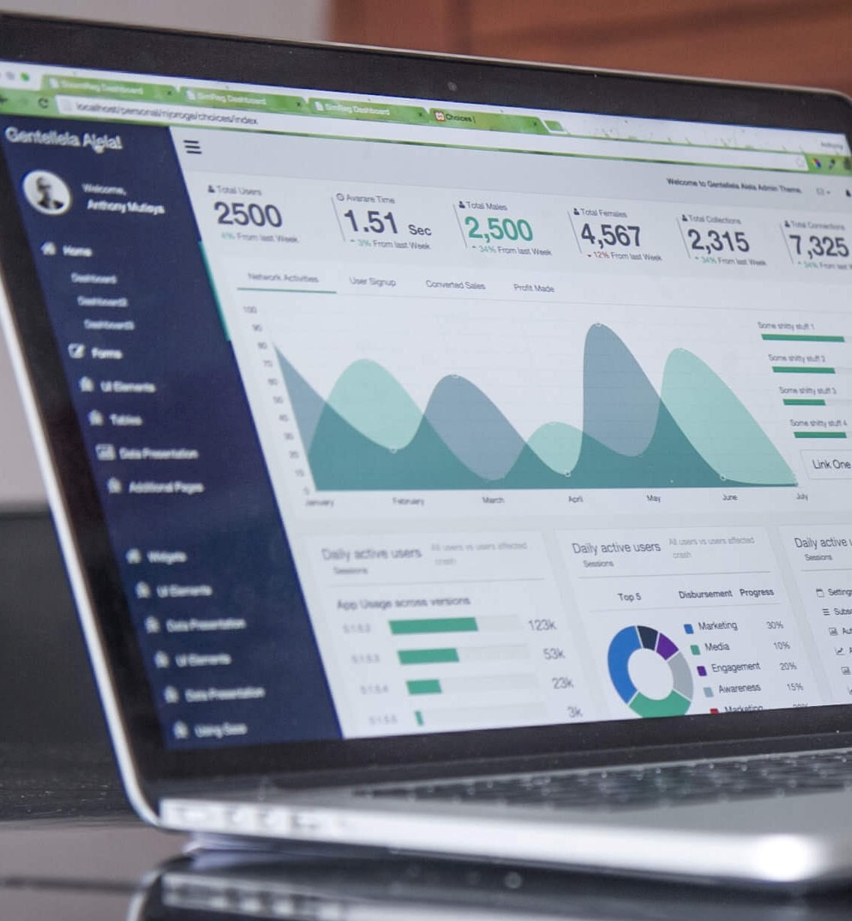
Exploratory data analysis
- Ask questions to find what are the key variables that are driving the churn
- Create visualizations for the churn rate for each variable
- Explore each feature's dependency with churn and create visualization for each
1. Count plot shows the distribution of the churn rate in the data which showed an imbalance in the data.
2. Categorical features count plot insights:
* Data is evenly distributed between the two genders; males and females, which might be useful in further analysis.
*Replacing 'No Internet Service' and 'No Phone Service' entries with 'No'**.
9
Notes:
Photo by Carlos Muza on Unsplash

Slide 10

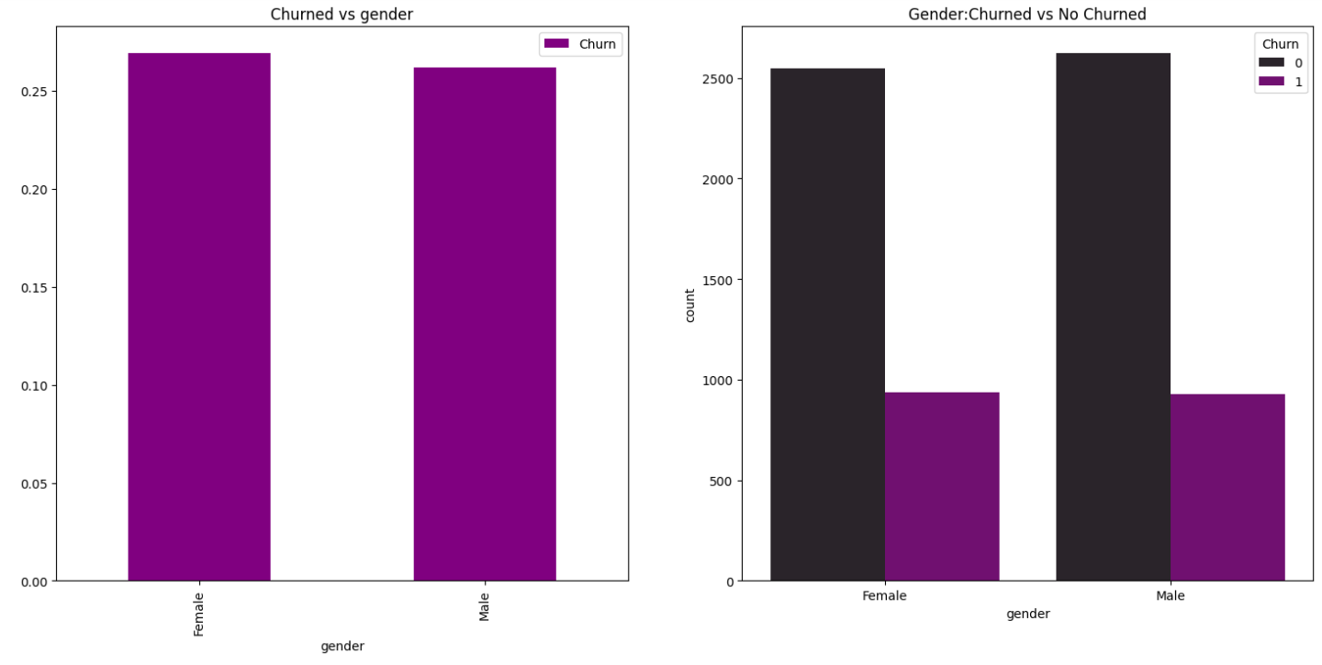
Number of customers is fairly evenly distributed between genders:
Female: ~3,400 total customers (2,500 retained + 900 churned) Male: ~3,500 total customers (2,600 retained + 900 churned)
Both genders show similar retention patterns:
Female: ~73% retained, ~27% churned, Male: ~74% retained, ~26% churned
Key Insights:
The even distribution of customers suggests no gender bias in customer acquisition.
Similar churn rates indicate that service quality and customer satisfaction are consistent across genders.
Current practices appear to be gender-neutral in their effectiveness.
Notes:
Photos by Freepik

Slide 11

Tenure Group distribution
Create a new variable that will divide
the customers in 3 tenure categories.
New: 0-6
Active/Regular: 7-64
VIP/Premium: 65-...
New Customers (0-6 months):
Almost equal churn vs retention (~700 each).
Highest churn rate among all groups (~50%).
Most vulnerable customer segment.
Active/Regular Customers (7-64 months):
Significantly better retention (~3,300 retained vs ~1,000 churned).
~23% churn rate.
Largest customer segment overall.
VIP/Premium Customers (65+ months):
Best retention rates (~1,000 retained vs ~100 churned).
Very low churn rate (~9%).
Strong loyalty in this segment.
Notes:
Photo by Campaign Creators on Unsplash

Slide 12

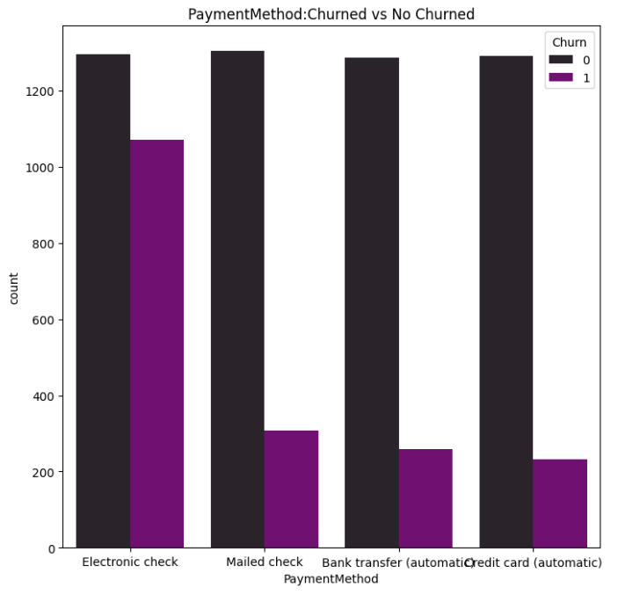
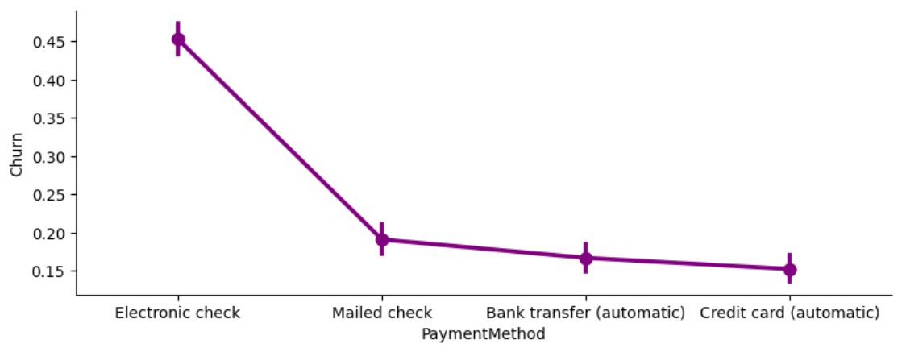
Payment Method
Credit card
21.6 %
Mailed check
22,9 %
1
3
2
4
•Key insights•
1.Payment method: Customers using electronic check have the highest churn rate, around 1000 churned customers compared to lower churn for other payment methods.
2.Specific to the electronic check payment, the number of customers using this method is also significantly higher than other options.
This combination of high usage and high churn suggests
this payment method may be a major driver of overall churn.
Electronic check
33,6 %
Bank transfer
21,9 %
Notes:
Photos by Jcomp / Freepik

Slide 13
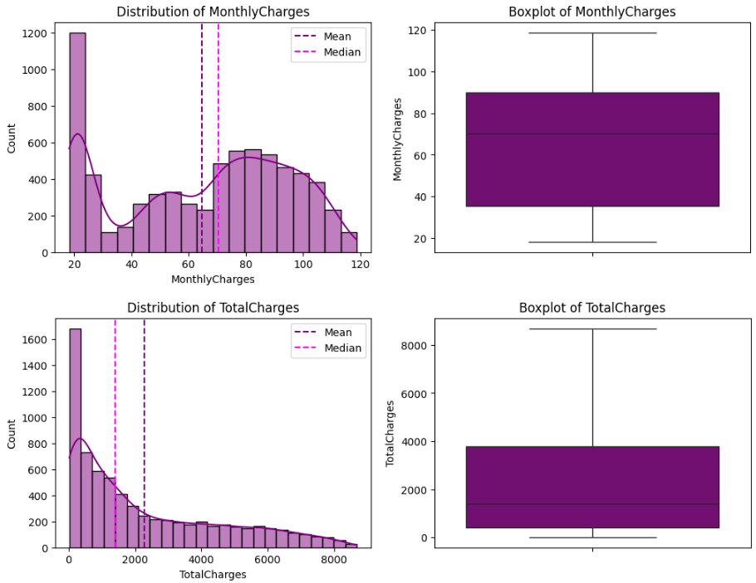
Distribution of Charges:
MonthlyCharges:
This column shows the monthly charges billed to the customers. The mean monthly charge is $32.37, with a standard deviation of $24.56, again indicating a wide range of charges. The minimum monthly charge is $18.25 and the maximum is $118.75.
TotalCharges:
This column shows the total accumulated charges for each customer over their tenure. The mean total charge is $2,281.92, with a standard deviation of $2,265.27. The minimum total charge is $18.80 and the maximum is $8,684.80.
Churn is more prevalent among customers with higher monthly charges.
Customers with low monthly charges (<$30) have a significantly lower churn rate.
Churn is higher among customers with lower total charges.
This indicates that new customers (those with low tenure) are more likely to churn.

Slide 14
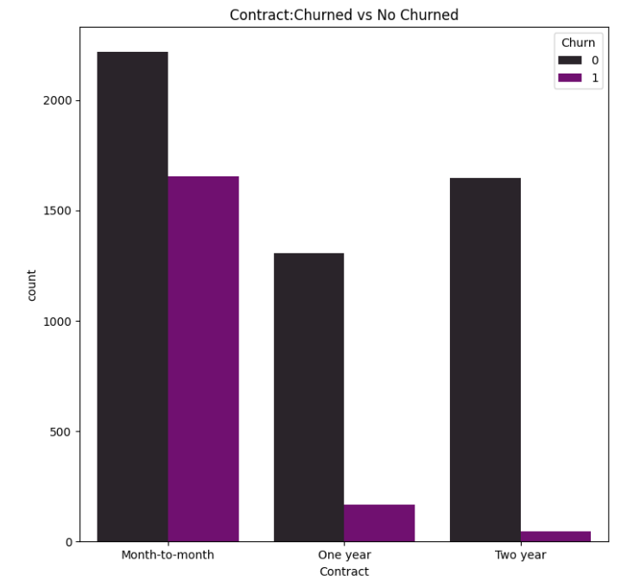
Contract
Month – to - month
55%
Month-to-month contracts have
a much higher churn rate compared to
longer-term contracts. The churn for
month-to-month is around 1500, while
for one-year and two-year contracts it drops significantly to under 500.
2.The number of customers on month-to-month contracts is also much higher, over 3000, compared to the longer-term contracts. This suggests month-to-month customers are more likely to churn.
3.For the longer-term one-year and two-year contracts, the churn is still relatively high, around 500 customers.
The key driver of churn appears to
be the prevalence of month-to-month
contracts, where customers are
more likely to cancel their service.
Two year
24,1%
One year
20,9%
14

Slide 15

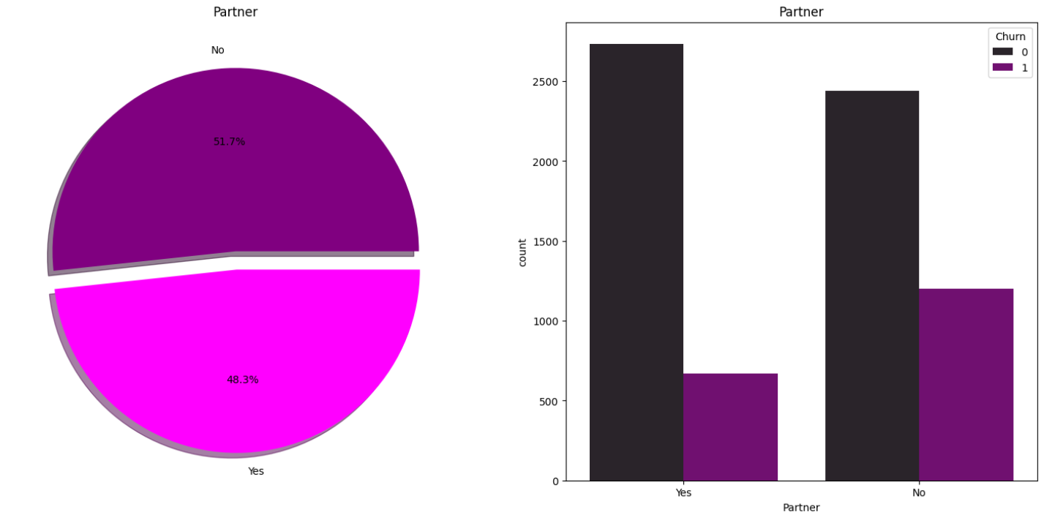
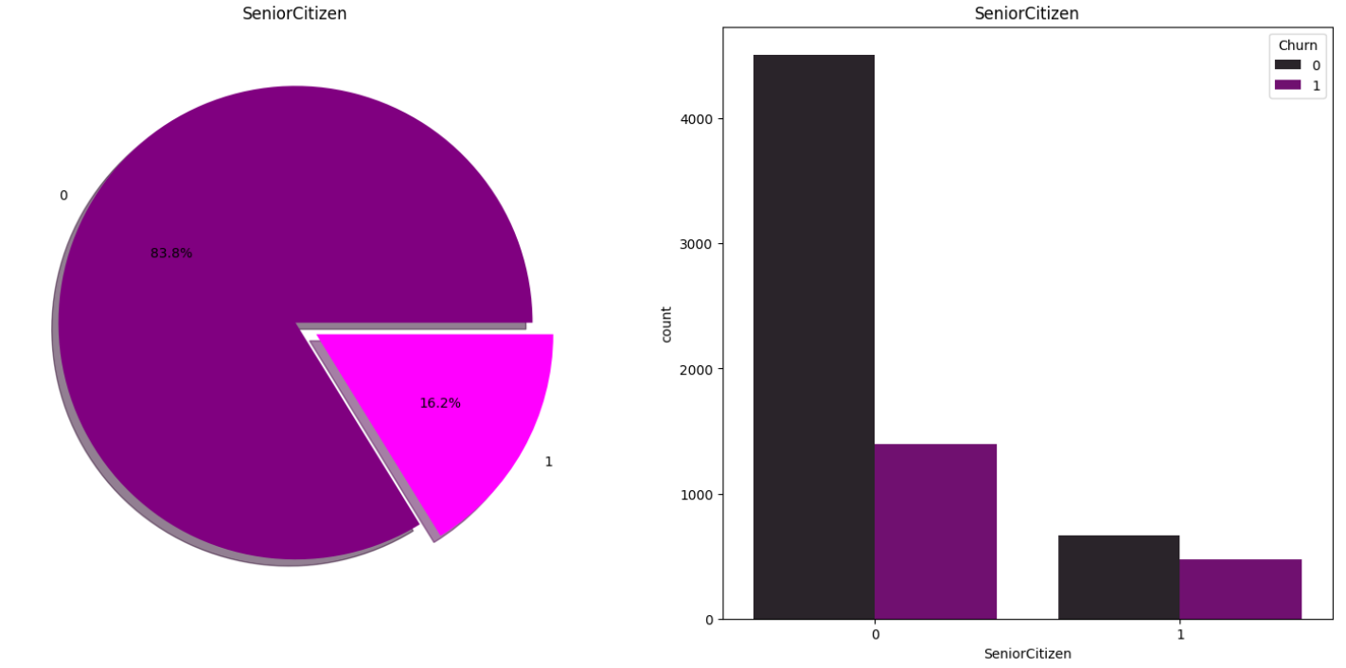
Partner and Senior Citizen Analysis
Pie Chart - Partner:
48.3% of customers have a partner, while 51.7% do not have a partner.
The data suggests that the customer base is fairly evenly split between those with and without a partner, but having a partner appears to be associated with a lower churn rate. This could indicate that the presence of a partner provides additional stability, support, or incentive for customers to maintain their relationship with the service provider.
Senior Citizen Distribution (Pie Chart) Observation:
The majority of customers (83.8%) are not senior citizens (0), while only 16.2% are senior citizens (1). This indicates that the customer base is predominantly non-senior citizens.
Churn by Senior Citizen Status (Bar Chart) Observation: For non-senior citizens (0), there are far more customers who do not churn compared to those who churn . For senior citizens (1), the proportion of churners is relatively higher compared to non-churners .
Notes:
Photos by rawpixel.com / Freepik

Slide 16
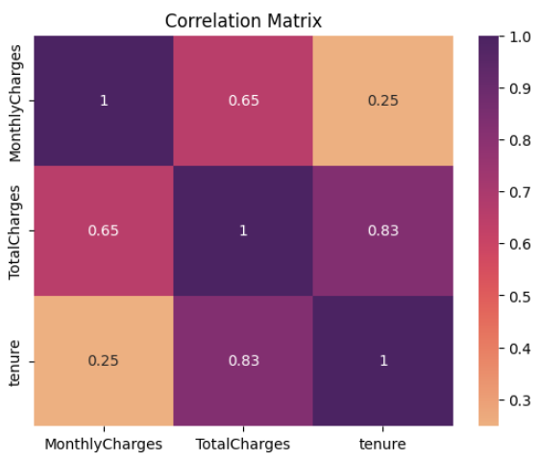
Correlation between numerical feature.
Here are the observations from the correlation matrix:
MonthlyCharges and TotalCharges:
The correlation coefficient is 0.65, indicating a moderate positive correlation. Higher monthly charges tend to be associated with higher total charges.
TotalCharges and Tenure:
The correlation coefficient is 0.83, which shows a strong positive correlation. Customers with a longer tenure are likely to have higher total charges.
MonthlyCharges and Tenure:
The correlation coefficient is 0.25, suggesting a weak positive correlation. There is only a slight tendency for customers with higher monthly charges to have longer tenure.
Observations:
The Columns “Total Charges” and “tenure” are very highly correlated.

Slide 17
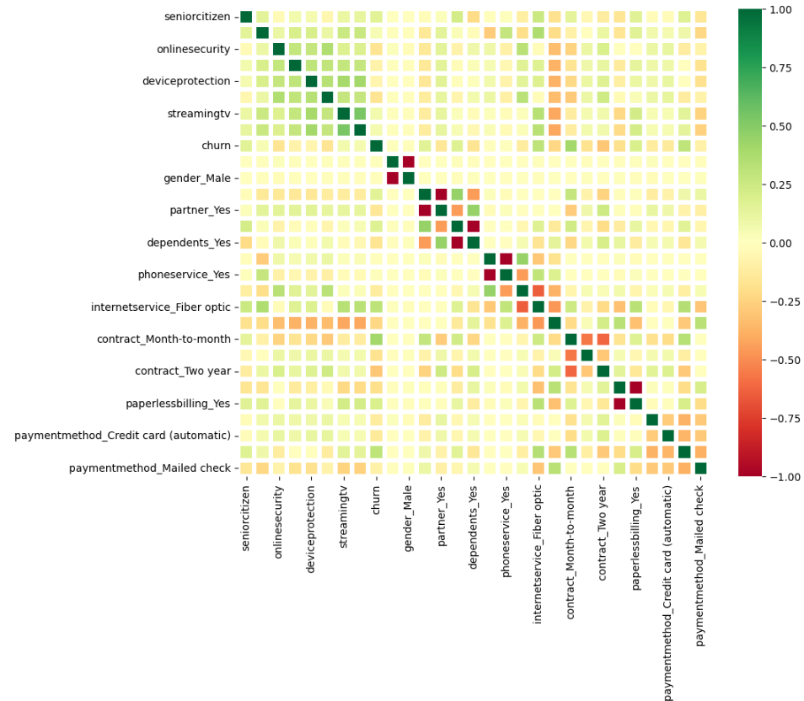
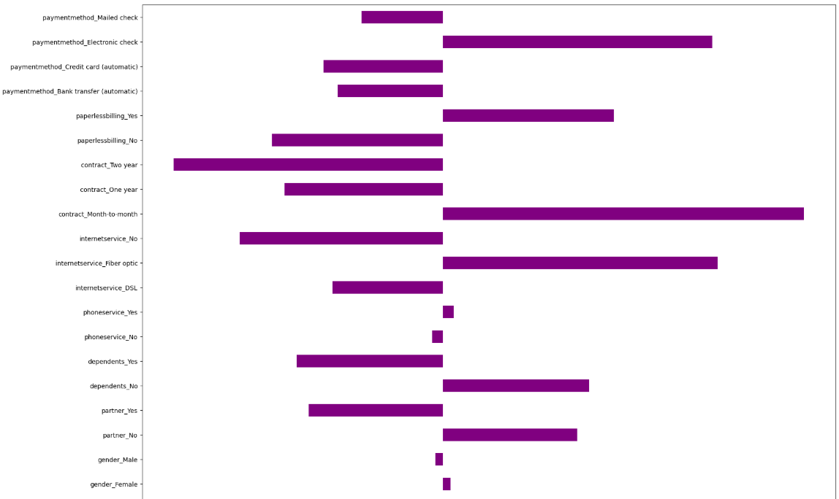
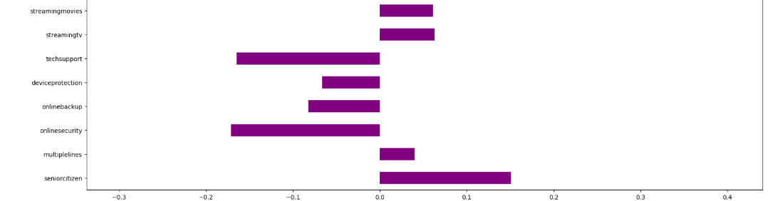
Executive Summary
Correlation
Notes:
Photos by creativeart / Freepik

Slide 18

ML Algorithms
We will predict the whether the customers will churn or not using some great Classification Algorithms. Following are the algorithms we will use to make the model:
XGBClassifier
GradientBoostingClassifier
Decision Tree
Random Forest
KNN - K Nearest Neighbors
Benchmark
Gaussian Naive Bayes
Radial Support Vector Machines(rbf-SVM)
Logistic Regression
Notes:
Photos by rawpixel.com / Freepik

Slide 19

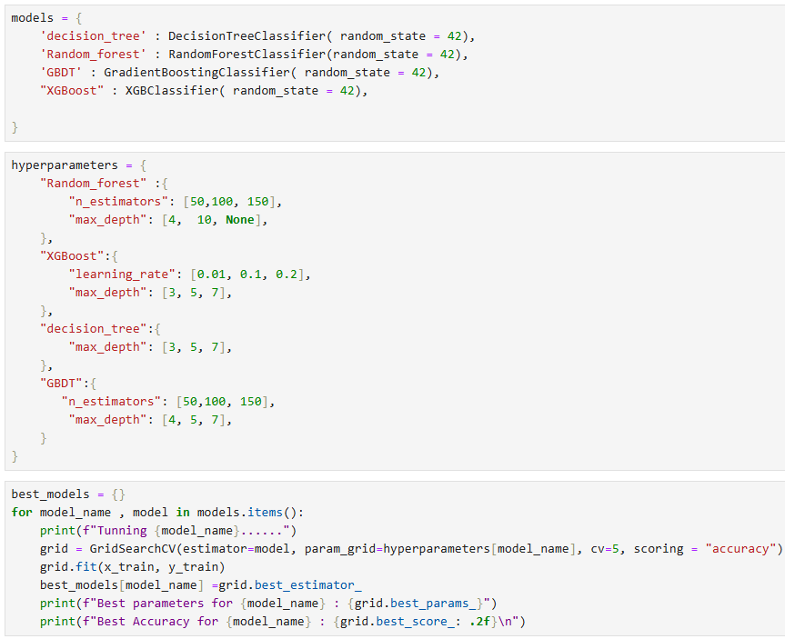
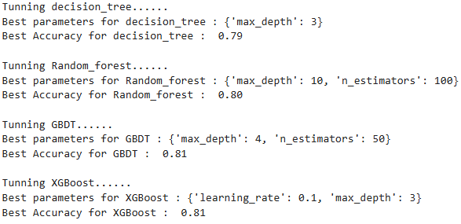
Best max depth and estimators for Classifiers!
Notes:
Photos by rawpixel.com / Freepik

Slide 20

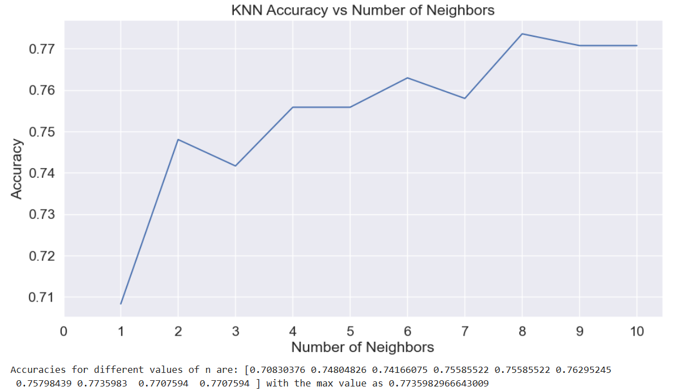
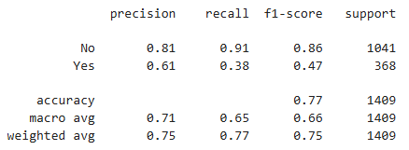
KNN - K Nearest Neighbors (The best n_neighbors=8)
The accuracy of the KNN is {0.7416}
Now the accuracy for the KNN model changes as we change the values for n_neighbours attribute. The default value is 5. Lets check the accuracies over various values of n_neighbours.
Place your screenshot here
The accuracy on training set is 0.820
The accuracy on test is 0.774
20
Notes:
Photos by Freepik

Slide 21

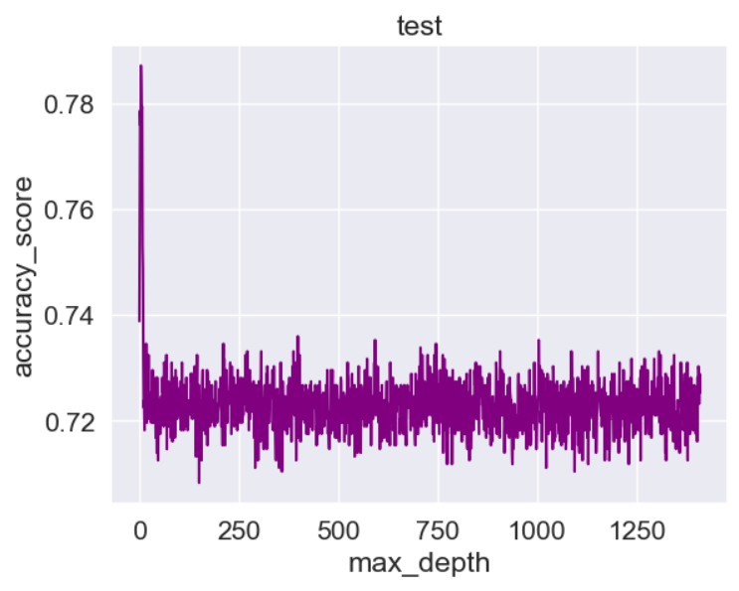
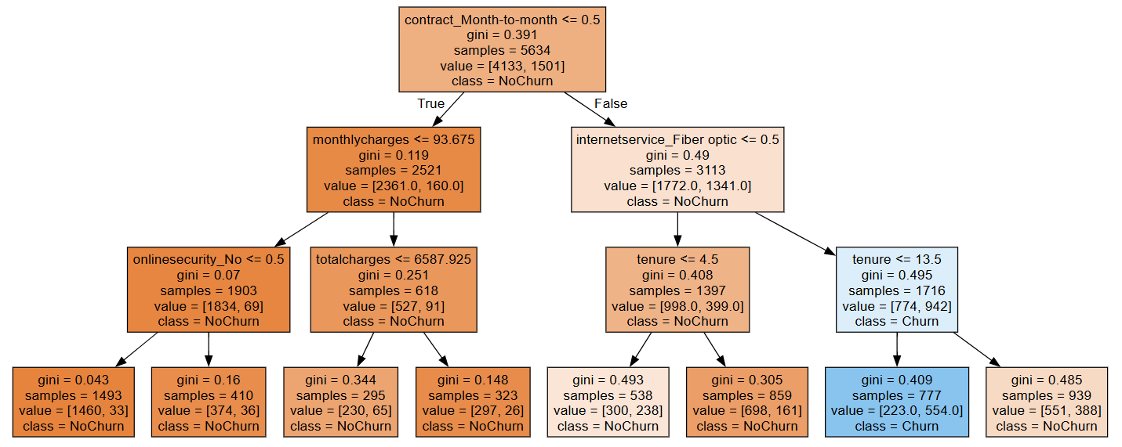
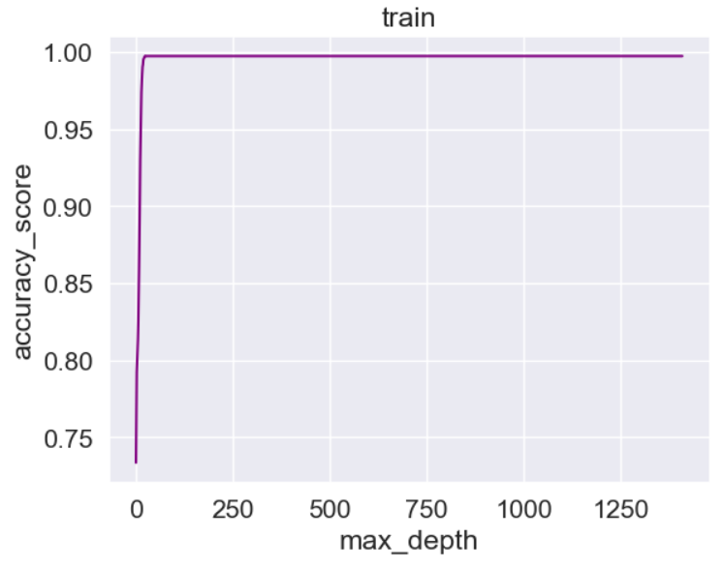
Decision Tree
Decision tree with different max depth values.
21

Slide 22
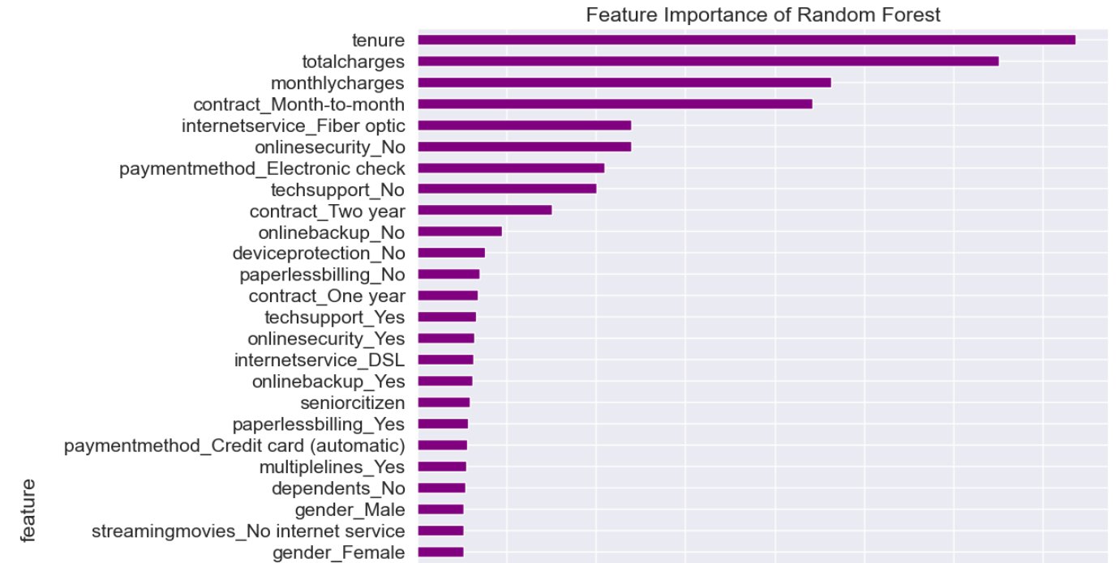
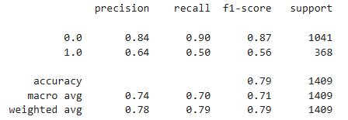
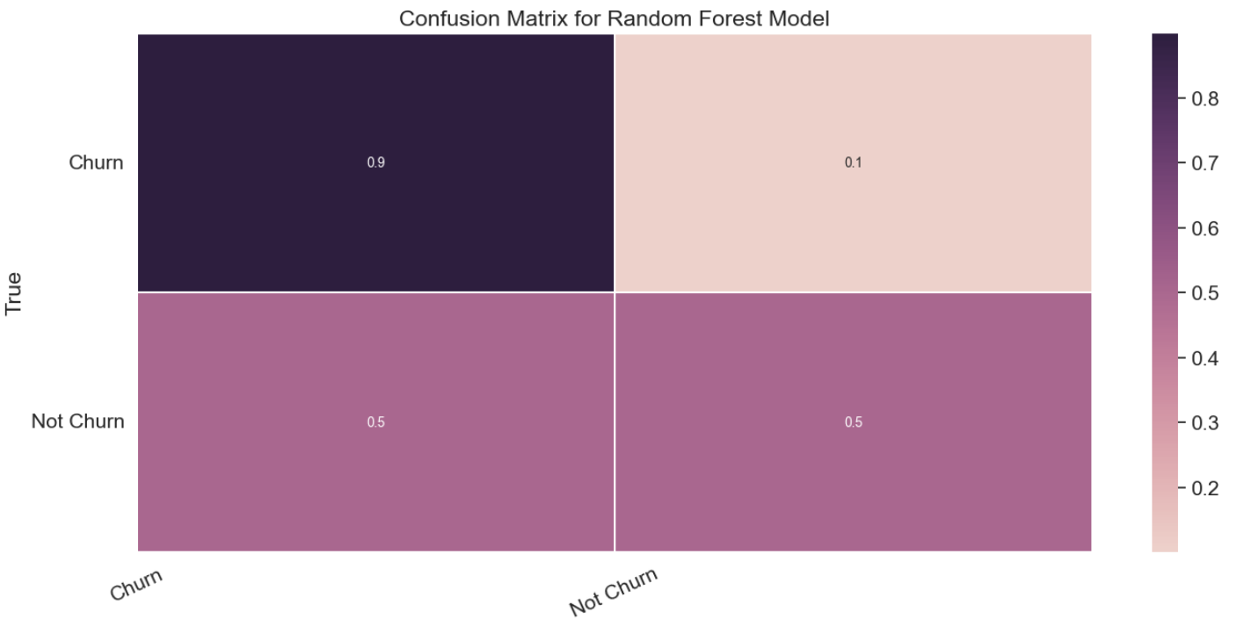
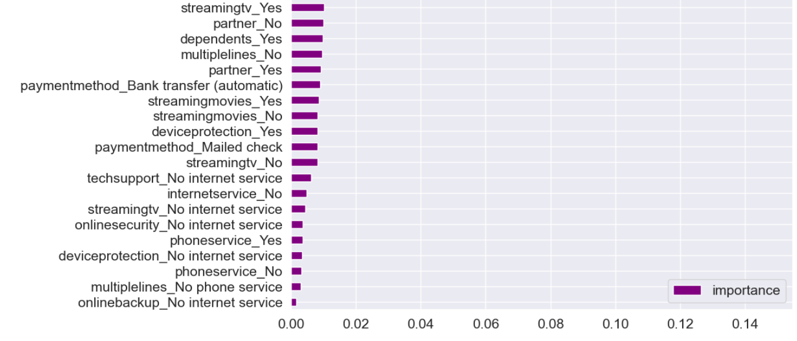
Random Forest model
Tunning Random_forest......
Best parameters for Random_forest : {'max_depth': 10, 'n_estimators': 100}
Best Accuracy for Random_forest : 0.80
Notes:
Photos by Evening_tao / Freepik

Slide 23
MODEL RESULTS
Benchmark:
Train Accuracy: 73.3%
Test Accuracy: 73.8%
Logistic Regression:
Train Accuracy: 80.8%
Test Accuracy: 79.8%
09
XGBClassifier:
Train Accuracy : 93.6%
Test Accuracy : 77.6%
01
Decision Tree:
Train Accuracy: 79.2%
Test Accuracy: 77.9%
08
Naive Bayes:
Train Accuracy: 70.6%
Test Accuracy: 69.1%
Churn
02
07
Customers
Random Forest:
Train Accuracy: 78.8%
Test Accuracy: 73.9%
SVM (Support Vector Machine):
Train Accuracy: 97.4%
Test Accuracy: 75.8%
03
06
GBDT:
Train Accuracy : 86.4%
Test Accuracy : 77.9%
KNN (K-Nearest Neighbors):
Train Accuracy: 73.4%
Test Accuracy: 73.9%
05
04
23

Slide 24
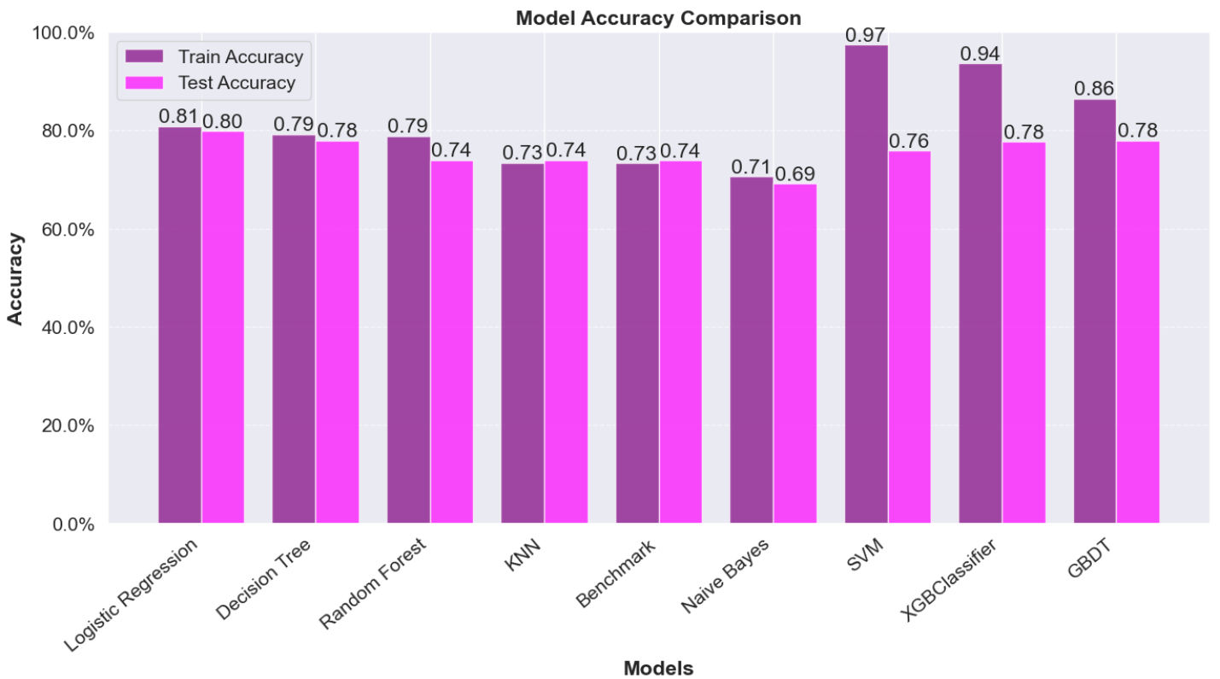
The best accuracy for all algorithms:
_____________________________________________________________________________________________________________
Recommendation for Churn Prediction
Logistic Regression:
Best choice for simplicity and consistent performance.
Ideal if interpretability is a priority.
XGBoost or GBDT:
These models should be preferred if you seek better performance with slightly higher complexity.
Parameter tuning is essential to reduce overfitting and maximize generalization.
Avoid:
SVM: Due to severe overfitting.
Naive Bayes: Due to low accuracy.
24
Notes:
Photos by Freepik

Slide 25

Results
Senior Citizen Status Insight: Senior citizens are more likely to churn than non-senior citizens.
Monthly Charges Insight: Customers with higher Monthly Charges are more likely to churn.
1
3
Payment Methods Insight: Customers paying via Electronic Check have the highest churn rate.
Customers with low Total Charges are more likely to churn. These are typically new customers with shorter tenures.
2
4
▪️ Average **monthly charges** is higher for customers who churn
▪️ Average **tenure** is shorter for customers who churn
▪️ Additional services (device protection, online security, online backup, tech support, streaming tv, streaming movies) are dependent on churn
25

Slide 26

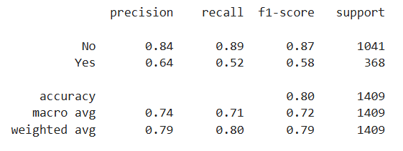
Recommendations
▪️ Raise price of month-to-month contract type and offer discounts for two-year contract to lead customers towards the other two contract types
▪️ Offer discount on device protection, streaming tv and streaming movies services
▪️ Offer online security, online backup, tech support services for free for one-year and two-year contracts customers
The machine learning model: logistic regression classifier is expected to predict churn with 81% accuracy on future unseen data.
Classification report
Notes:
Photo by Luke Chesser on Unsplash

